Slide 1
Yagi-Uda Antenna Design
Antenna Engineering Sessional Project

Slide 2
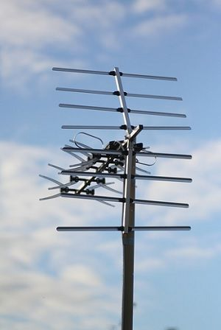
Yagi–Uda antenna
Practical Yagi-Uda-Antenna

Slide 3
The Yagi is very widely used as a high-gain antenna on the HF, VHF and UHF bands.
Yagi antenna, is a directional antenna consisting of two or more parallel resonant antenna elements in an end-fire array.
It has moderate to high gain depending on the number of elements present.

Slide 4
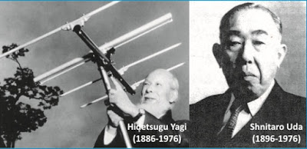
Origins
Invented in 1926

Slide 5
Consists of a number of parallel thin rod elements in a line, usually half-wave long.
There is a single driven element in the center
A variable number of parasitic elements.
A single reflector on one side and optionally one or more directors on the other side.

Slide 6
Advantages:
Lightweight, Compact Size & Lower in cost
Offers Wide bandwidth
Good unidirectional Radiation Pattern
Substantial increase in directivity and gain

Slide 7
Disadvantages:
Doesn’t offer very high gain
Sensitive to frequency
Obstructive design

Slide 8
Theory of operation
The frequency range in which the Yagi-Uda antennas operate is around 30 MHz to 3GHz which belong to the VHF and UHF bands.
There are many directors placed to increase the directivity of the antenna. The feeder is the folded dipole. The reflector is the lengthy element, which is at the end of the structure.
For this antenna to be designed, the following design specifications should be followed :

Slide 9
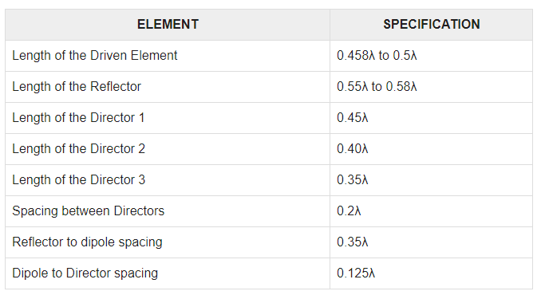

Slide 10
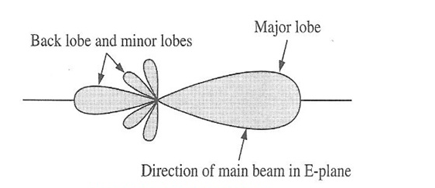
Radiation Pattern
Radiation Pattern of Yagi-Uda Antenna

Slide 11
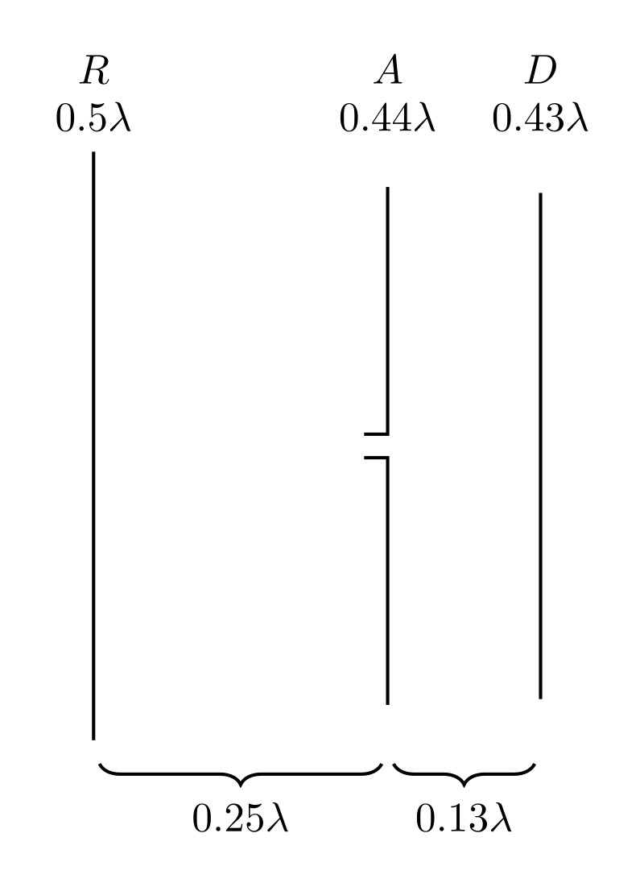
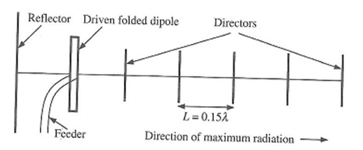
Description

Slide 12
Parameters
S-Parameters
VSWR
Gain
Directivity

Slide 13
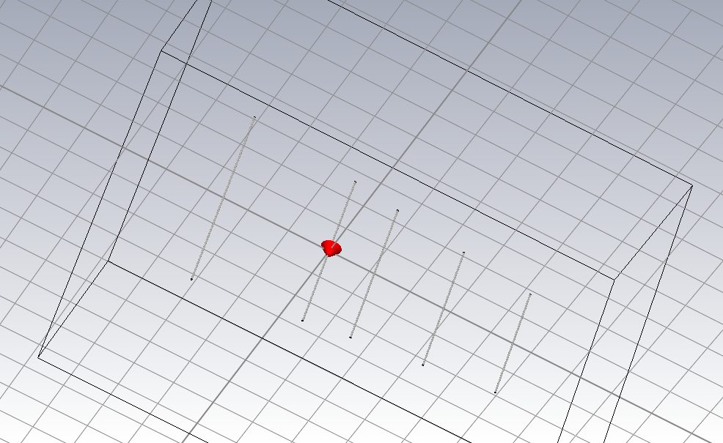
Antenna Design- (PEC Material Approach)

Slide 14
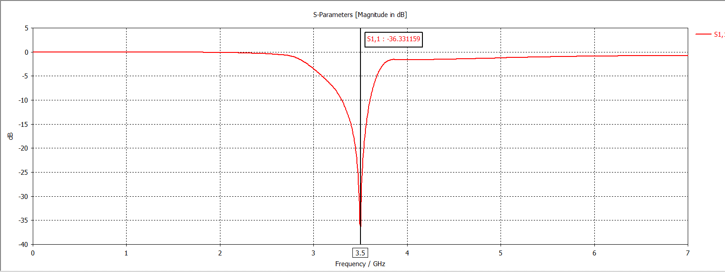
S-parameter:
Value of S parameter is S1,1: -36.33159

Slide 15
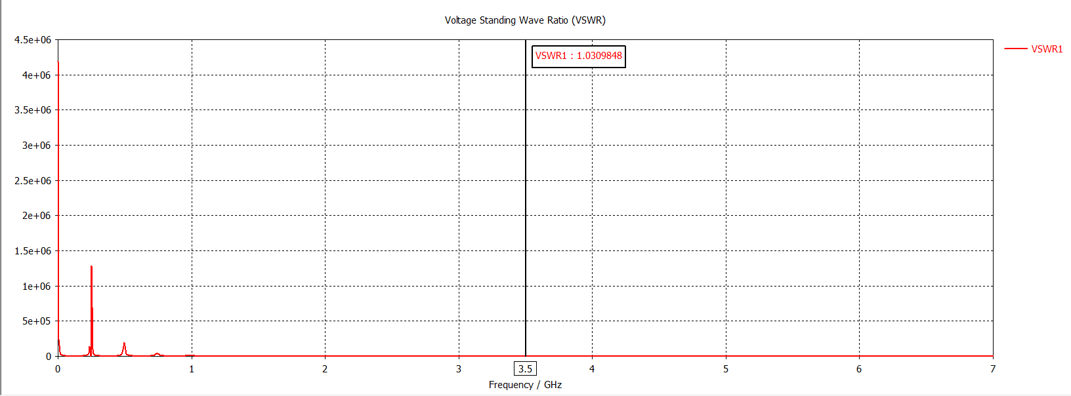
Voltage Standing Wave Ratio
VSWR value ---- 1.0309848

Slide 16
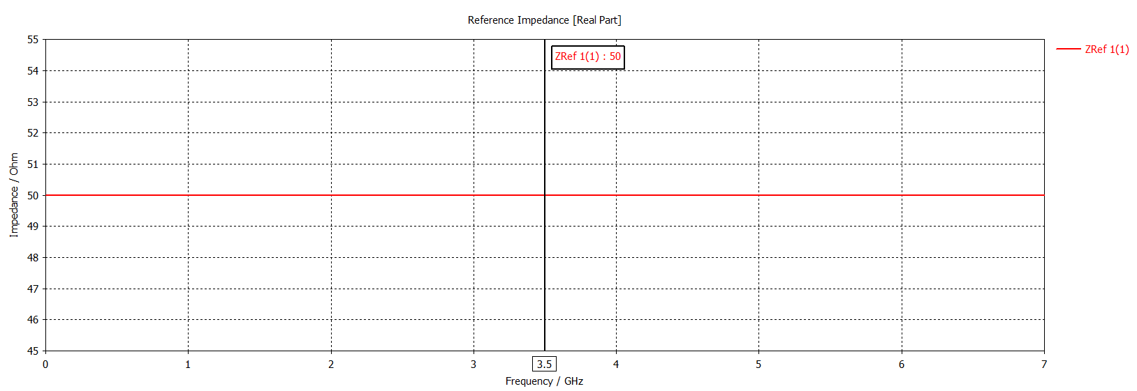
Reference Impedance

Slide 17
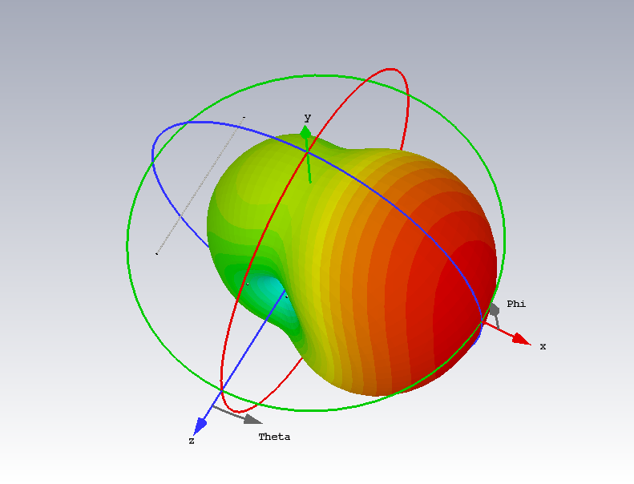
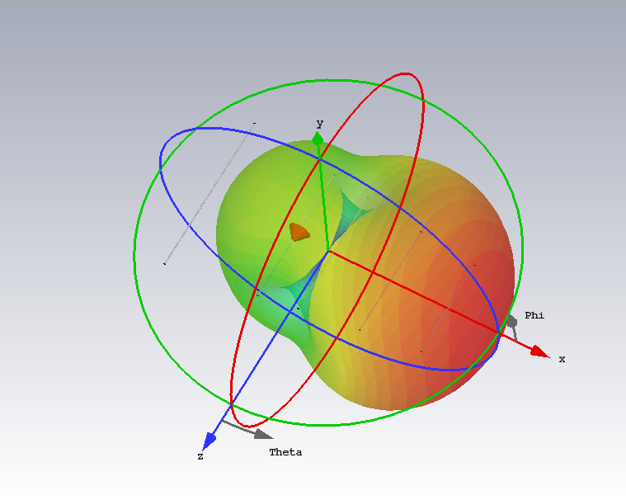
Far-field
Far-field Without Transparency
Far-field With Transparency

Slide 18
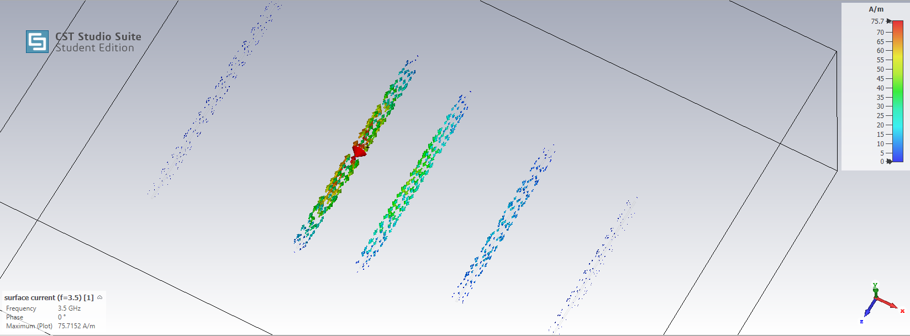
Surface Current

Slide 19
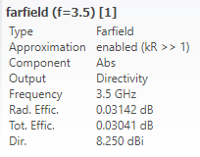
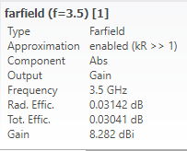
Directivity
Gain

Slide 20
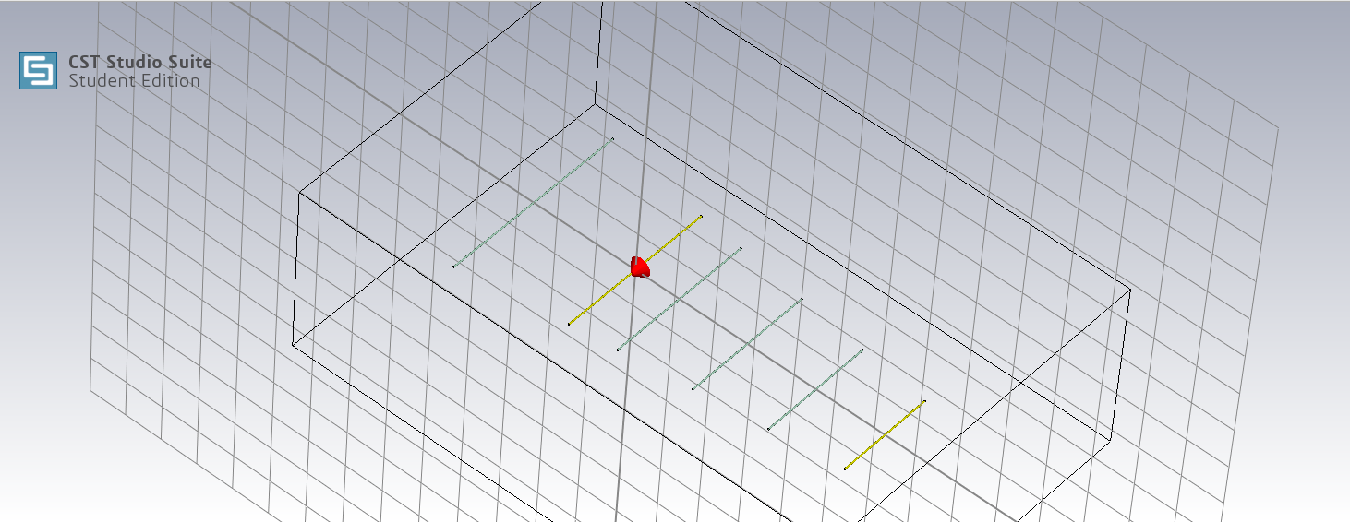
Antenna Design (Alumina & Copper Approach)

Slide 21
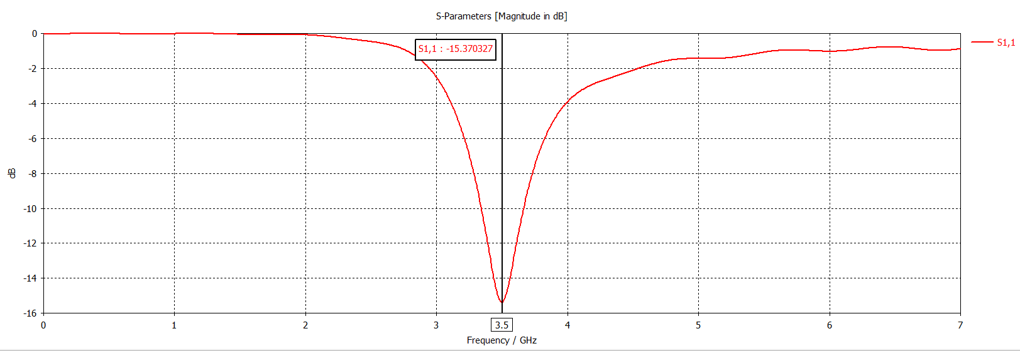
S-Parameter
S-Parameter value S1,1: -15.370327

Slide 22
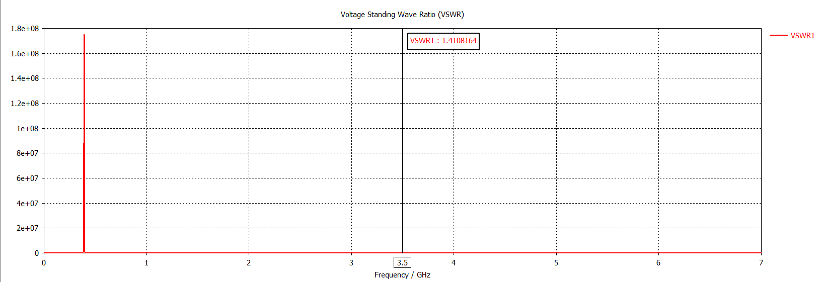
Voltage Standing Wave Ratio
VSWR Value: 1.4108164

Slide 23
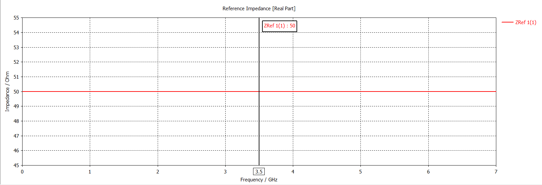
Reference Impedance

Slide 24
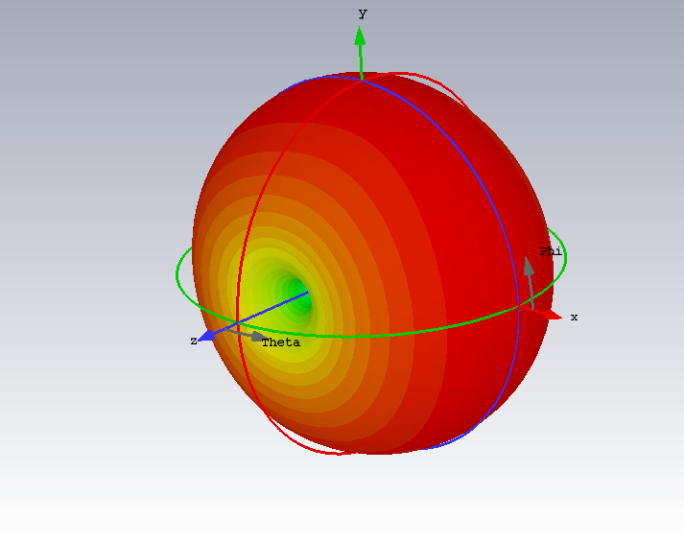
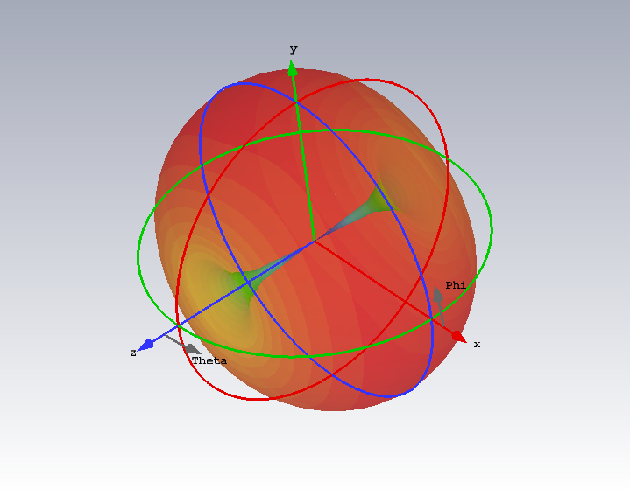
Far-Field
Far-Field Without Transparency
Far-Field With Transparency

Slide 25
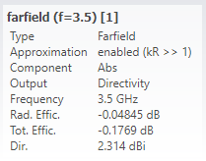
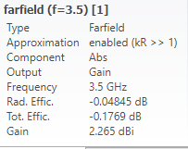
Directivity
Gain

Slide 26
Thank You
Presented By:
Fardin Shahriar
Al-Amin Abir
Soyabul Islam
1709026
1709027
1709028

